Slide 1


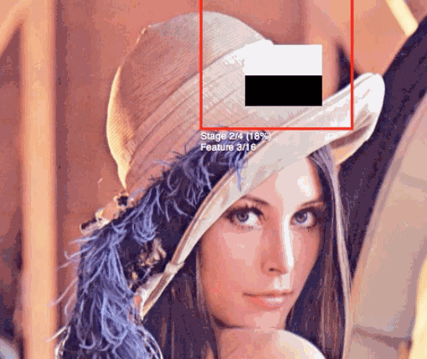

Technologies/ Algo used
Viola-Jones Algorithm

Slide 2

Project Overview
After the breakout of the worldwide pandemic COVID-19, there arises a severe need of protection mechanisms, face mask being the primary one.
The basic aim of the project is to detect the presence of a face mask on human faces on livestreaming video as well as on images. We have used machine learning to develop our face detector model.
We have used basic concepts of transfer learning in neural networks to finally output presence or absence of a face mask in an image or a video stream.
Experimental results show that our model performs well on the test data with 100% and 99% precision and recall, respectively.
Notes:
What is the project about?
Define the goal of this project
Is it similar to projects in the past or is it a new effort?
Define the scope of this project
Is it an independent project or is it related to other projects?
* Note that this slide is not necessary for weekly status meetings

Slide 3

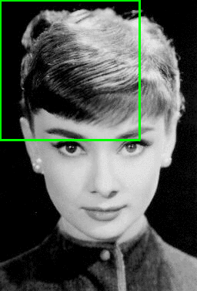

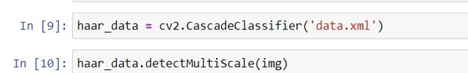
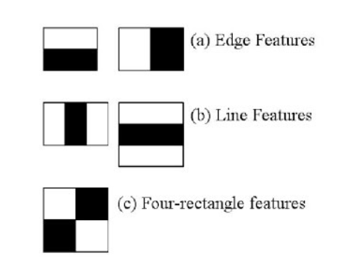
Viola-Jones Algorithm

Slide 4
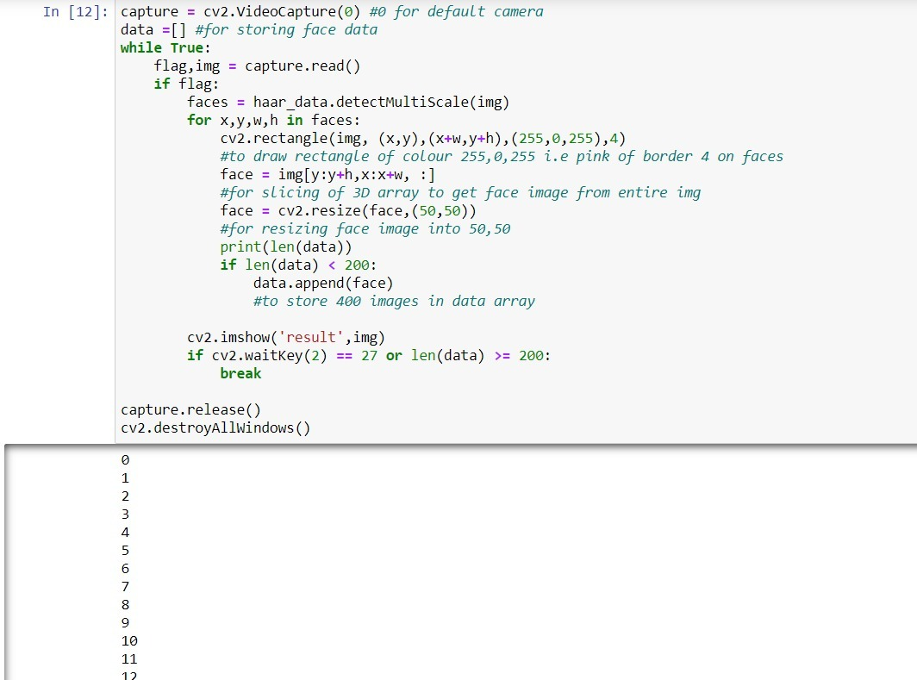
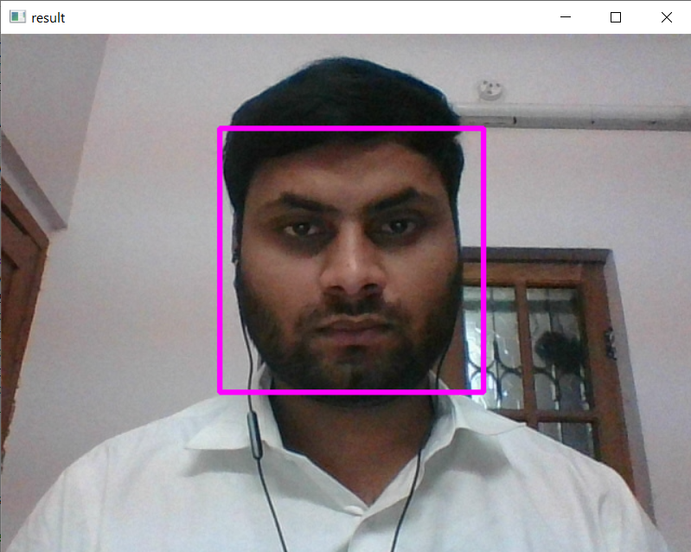
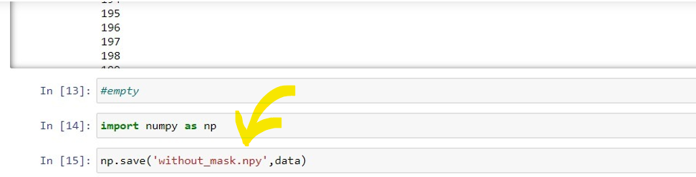

Collecting Images without mask

Slide 5
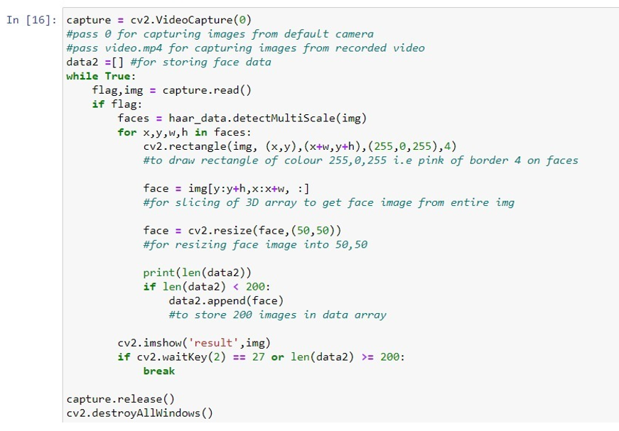
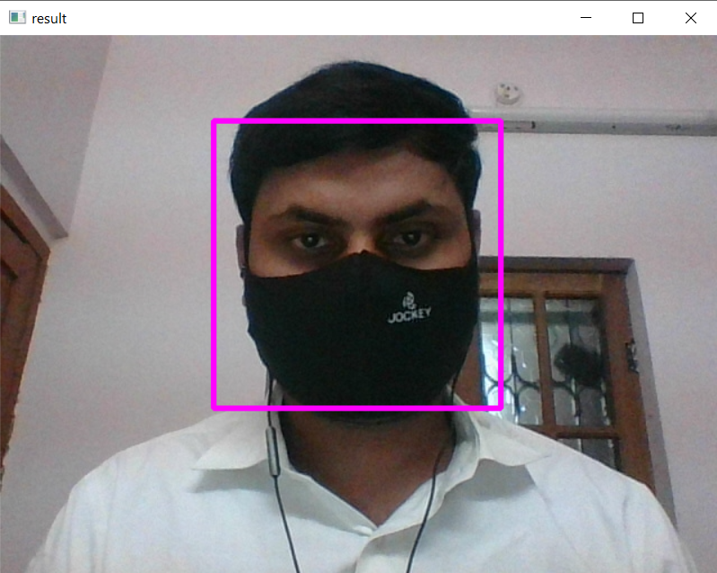

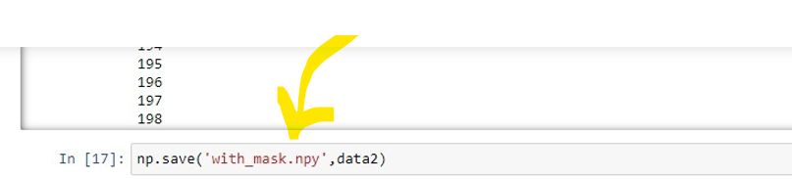
Collecting Images with mask

Slide 6
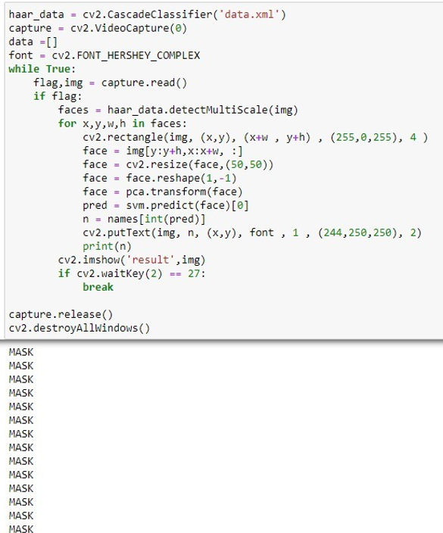
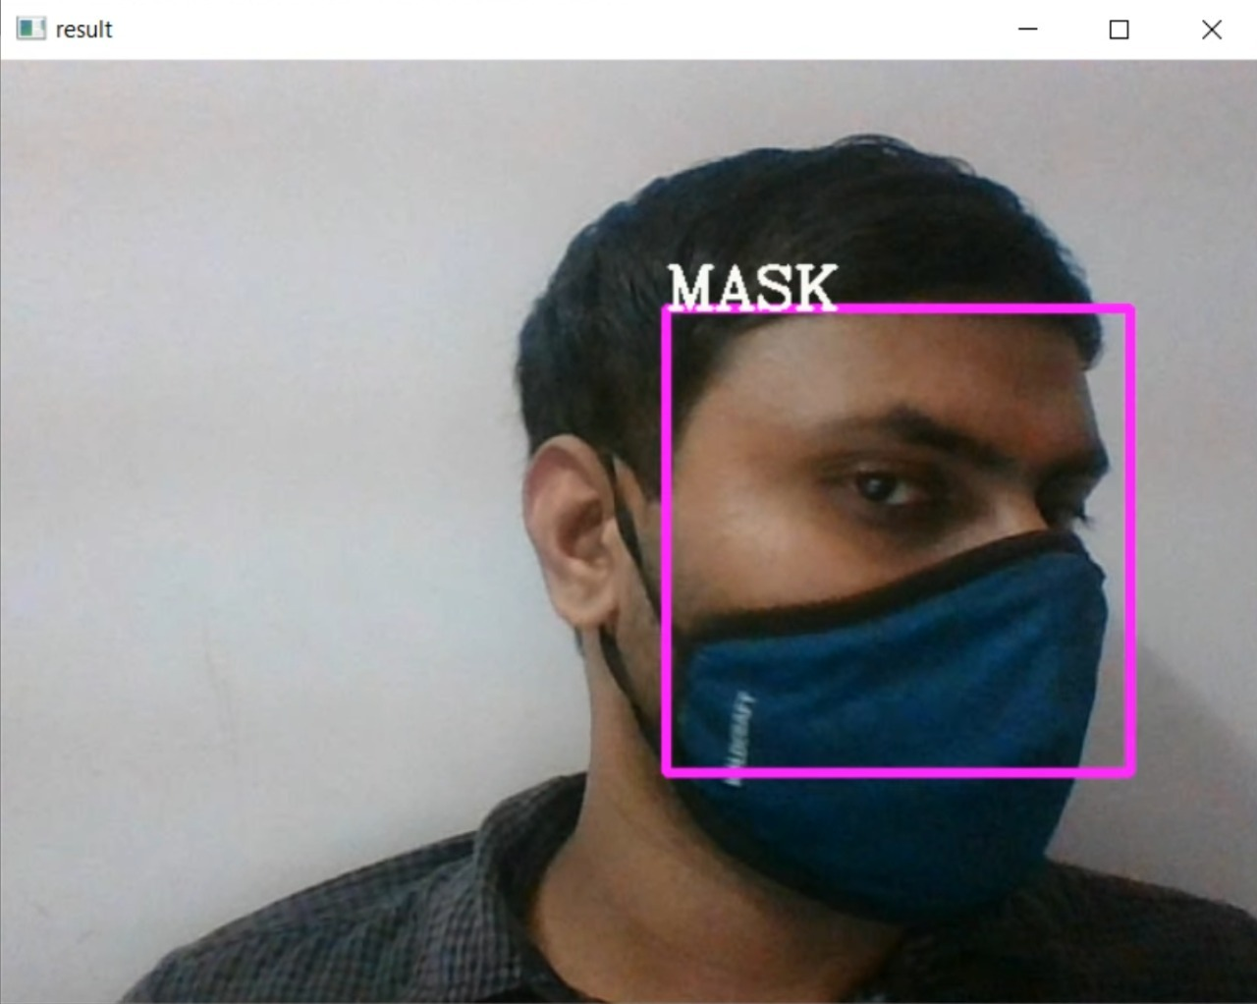
Detection

Slide 7
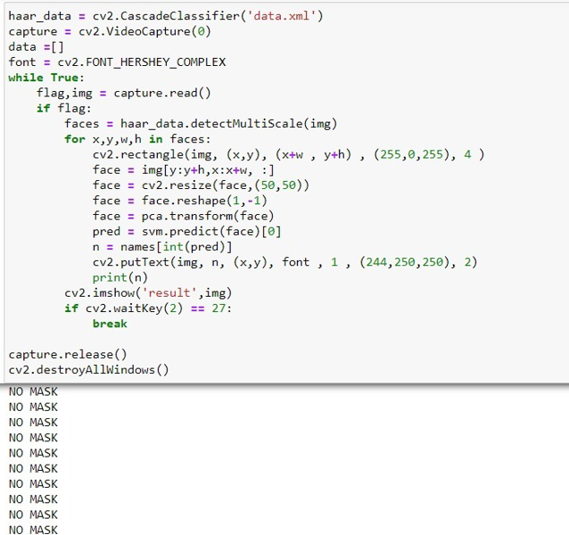
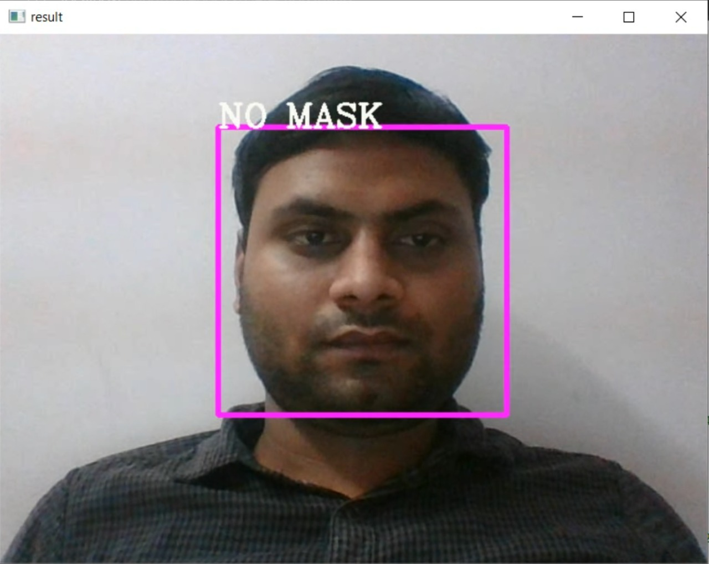
Detection

